Slide 2
Event Manager and Script Engine
IDE and Scripting Standards
2015

Slide 3
What Is An IDE?
IDE – Integrated Development Environment
Software application designed to streamline software development process
Maximize time spent developing
Reduce time managing and maintaining source code

Slide 4
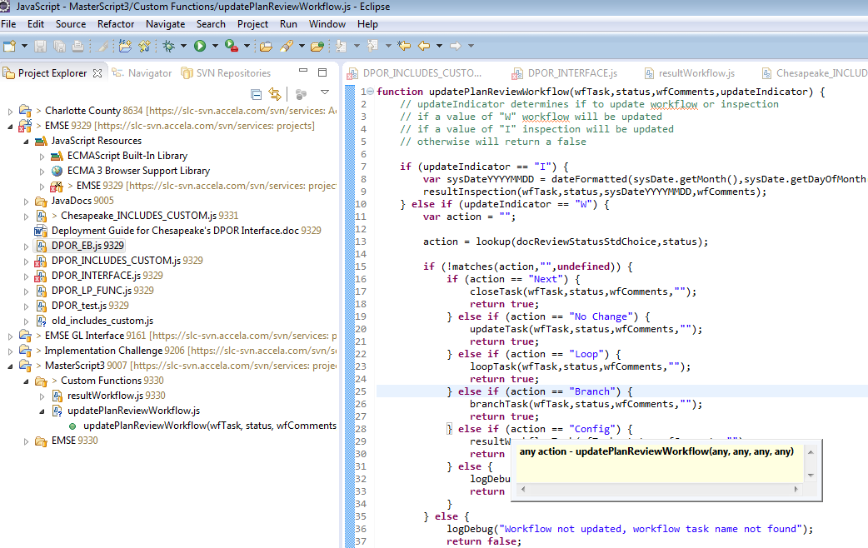
Eclipse
Commonly used open source IDE
Provides out-of-the-box JavaScript development aids with intellisense support
Provides out of the box integration to common source control software packages
Built in code formatting and syntax checking

Slide 5
Resources
Eclipse website
http://www.eclipse.org
EMSE Development Environment Setup
EMSE_Development_Environment_Setup.docx

Slide 6
Scripting Standards

Slide 7
Why Have Standards?
Easier to maintain code
Promotes collaboration
Promotes code reusable
Streamlines onboarding new staff
Simplifies the debugging process

Slide 8
What Is A Standard
Defines the general structure uses for coding blocks
Ex. how to start and end if statements if(true) { };
Provides guidelines for naming for how to name your variables
Ex. I_AM_A_GLOBAL = true;
Provides examples how to scope and type variables
Ex. var x = true;

Slide 9
Accela Script Standards

Slide 10
Declaration
Always use ‘var’ when declaring a variable
var myVariable = null;
Define object and arrays when they are known var myArray = new Array();
var myArray = [];
var myObject = new Object();
var myObject = {};

Slide 11
Naming
functionNamesLikeThis
function getRecordName();
variableNamesLikeThis
var recordId = capId;
ClassNamesLikeThis
function AddressObject(pId){
this.address = pId;
};
GLOBALS_LIKE_THIS
MY_INTERFACE_URL = "http://www.accela.com";

Slide 12
Indentation
Open brace on same line as statement. Closure at same indentation as initial statement
if (true) { /* Initial Statement */
// Statements …
} /* Close Brace */
else{
// Statements …
};

Slide 13
Indentation Continued
Nesting adds indentation
if (true) {
if (true){
// Statements…
}
}

Slide 14
Code Comments
Task Tags. Use the following to generate tasks for Eclipse and most IDEs
//TODO: work still needing to be complete
//FIXME: identified defects needing to be fixed
Single Line Comments
if (true) {
var x = false;
}; //End If
Multiline Comments
if (true) {
/*
my Comment
*/
};

Slide 15
Code Comments Continued
JSDoc Comments for all functions
/**
* results workflow task and sets the status and performs next step based on configured status
* @param {string} wfstr
* @param {string} wfstat
* @param {string} wfcomment
* @param {string} wfnote
* @param {string} [wfprocess]
* @returns {Boolean}
*/
function resultWorkflowTask(wfstr,wfstat,wfcomment,wfnote)

